Slide 1

Missing Data Adjustments
An Application to the Crown Court Sentencing Survey

Slide 2
Index
The implications of missing data
Imputations
  Functioning: single and multiple imputation
  Application to the CCSS
Weighting
  Functioning
Comparison of pros and cons
Notes:
I am basically going to talk about the two family of methods for the adjustment of MD.
I am not going to explain them in detail.
I have tried to make it as intuitive as possible at the expense of making some technical simplifications, but let me know if everything make sense or if you want me to stop at any moment to explain something in more detail.

Slide 3
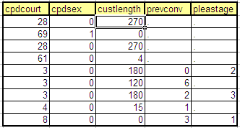
The Implications of Missing Data
Notes:
Through this presentation I use an excerpt of data from the CCSS with 5 variables and 9 cases.
The 3 first variables belong to the MOJ dataset, this is a dataset that registers a few features of every offence judged in England and Wales (here I use Court where the offence was dealt with, sex of the offender, and custodial length in days).
The last 2 variables were captured by one of the CCSS questionnaires (number of previous convictions of the offender, and when was a guilty plea entered). Here we can see that there are some cells without a value, and that’s what missing data is.
In particular I show two missing data mechanisms, the one affecting previous convictions seems to be related to what is known as unit-nonresponse (that is, entire questionnaires which were not returned to us), plea stage on the other hand seems to be affected that mechanism, but also to another one which seems to affect plea stage but not previous convictions. This is what is known as item-nonresponse, which reflects cases where we get back the questionnaire, but certain questions are left unanswered.

Slide 4
The Implications of Missing Data
Loss of statistical power;
Potential bias if the missing data is non-ignorable.
Ex.1, judges that tend to forget to fill their questionnaires might also be the ones minding less the guidelines.
Notes:
An immediate implication of missing data is that it makes the sample lower, this is a problem because it is harder to find trends or any statistical effect going on in the population of interest.
A bigger problem can also take place if the missing data is non-ignorable.
Missing data is always non-ignorable if the mechanism that makes the data to go missing is not a random process;
e.g. the wind starts blowing and some of your questionnaires get in a lake and they are totally spoiled.
However, the most likely scenario is that the missing mechanism won’t be random and will be associated to some of your variables of interest,
Ex.1 our results on consistency might be biased because the offences for which we do not have records might have been passed by more lenient judges, who either forgot or willingly decide not to fill questionnaires, but who are also the ones that pay less attention to the guidelines.
Ex.2 in the excerpt above, the average number of previous convictions is 2.4, but we do not know what is the real average in the population.

Slide 5
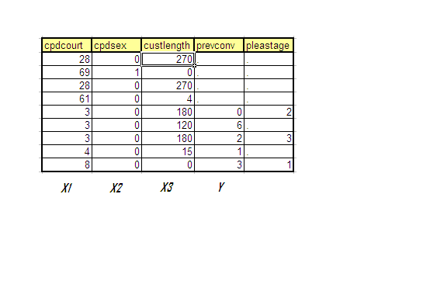
Imputations
1st the dataset is ranked in order of missingness
Notes:
First, we order the data in decreasing order of completeness, or increasing order of missingness, the excerpt I showed before is already ordered,
i.e. previous convictions has more missing data than any of the moj variables, but less than pleastage.

Slide 6
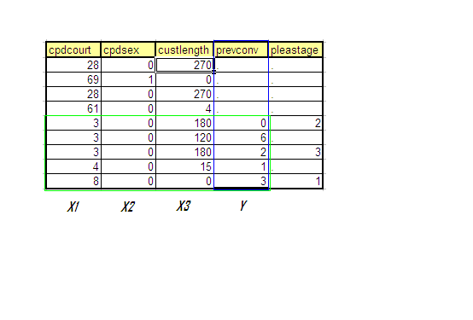
Imputations
2nd an imputation model is estimated
Notes:
Then we generate a first set of imputations for previous convictions.
We do that by running a model with previous convictions as the response variable, and all the other variables except pleastage as explanatory variables, but using only the cases that are complete, here those captured by the green rectangle.
Once the model has been estimated using the “green data”, we generate predictions for the rest of values of previous convictions based on the regression coefficients of that model but the data from the cases we want to impute.

Slide 7
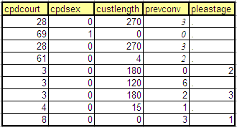
Imputations
3rd we make predictions from the imputation model
Notes:
The predictions for the values of previous convictions are included as imputations (notice the different font), and the same process is repeated for plea stage.

Slide 8
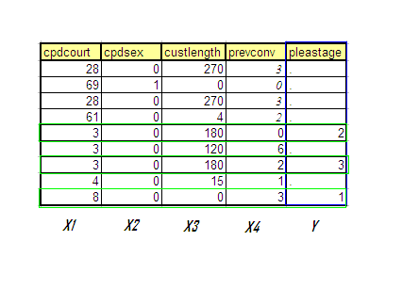
Imputations
4th steps two and three are repeated
Notes:
We now make use of the moj data, but also of previous convictions, we run that model using the complete cases, and generate new predictions.
Notice that in this case, or in any other with more than one missing data mechanism, in predicting missing cases we might start using imputed observations from other variables. I will come back to this issue to illustrate why I don’t think that imputing data is not the best solution for the CCSS.

Slide 9
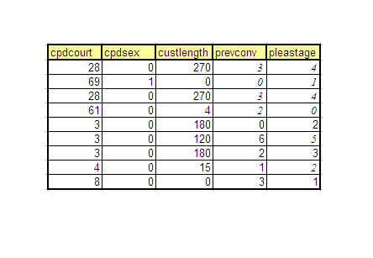
Imputations
Until we got a complete dataset
Notes:
Finally, once the data has been imputed you use the dataset as if it was a complete dataset.
These imputations have the benefit that they allow you using all of your data, and normally they can adjust (to a certain extent) for the biases caused by non-ignorable missing data.
For example the average of previous convictions was 2.4 and now is 2.22, so it seems offences for criminal with lower previous convictions tended to go missing more often than the ones with more convictions.
This might be a good idea when we want to report totals or even means, but beyond the estimation of those simple statistics there are problems related to using imputed data (synthetic) as if it was real data.
Mainly there are problems related to how do we represent that the imputed data is an estimate and therefore there is uncertainty around which value should it really have.

Slide 10
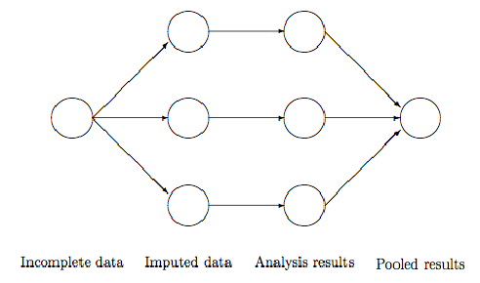
Multiple Imputations
Notes:
The problem of transposing uncertainty to your new dataset was solved by Rubin, the statistician that invented multiple imputation.
Multiple imputations, as its name conveys, consists on imputing more than one value for each missing case.
The idea is to run a model somehow similar to what I have shown before which can give us different predictions that reflect the uncertainty regarding the missing cases.
In particular, following the example that I show in this diagram 3 values are imputed for each missing cases.

Slide 11
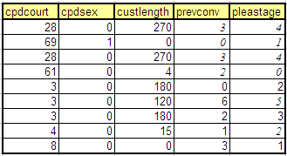
Multiple Imputations
Notes:
So what we get after performing the imputations are 3 datasets which have identical cases except for those which were missing, which now have slightly different imputations.
Once we have this multiple datasets with complete data we can run any kind of analysis, which we do by replicating the same analysis for each of the datasets.

Slide 12


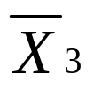
Multiple Imputations
Notes:
For example, here I am estimating the mean of previous convictions, and I do so in each dataset.
I know that because the imputations differ the means from each dataset are not going to be the same, that’s why I use different subscripts.
In a final stage the results from each of the datasets are pooled.

Slide 13

Multiple Imputations
Notes:
In this particular case that is done by taking the mean of the (3) means,
and that would be our final estimate which adequately reflects the uncertainty due to missing data while trying to adjust for the bias due excluding cases with non-ignorable missing data.

Slide 14
Problems with the CCSS
Rooting / structural dependencies.
Lack of identifiability between item non-response and non-applicable.
Notes:
I have spent some time know trying to apply this technique to the CCSS dataset but I have found some issues that make it both more difficult and less valid.
In particular there are two main issues: structural dependencies and non-identifiability.

Slide 15
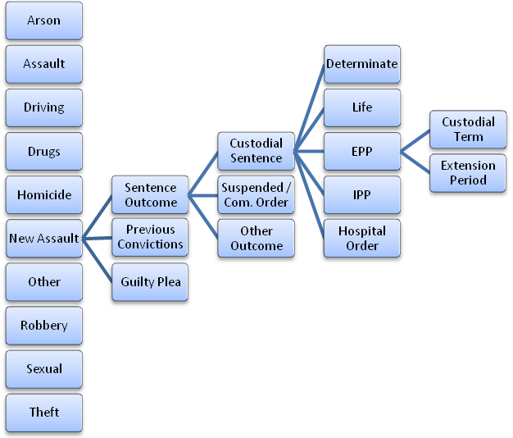
Problems: Structural Dependencies
A Segment of the hierarchy of dependencies
Notes:
By rooting, or structural dependencies I am referring to this structures that we often see in questionnaires that say if you responded a go to question 15, if you responded b go to somewhere different.
These dependencies need to be identified and specified in the imputation model, otherwise you risk including nonsensical cases like the one of an offender that was given a fine, but for whom 300 days of custody was imputed.
The problem is that there are so many of them that even identifying them is pretty hard, but most importantly, there is an issue with the statistical power of the model.
Basically the specification of the structural dependencies is equivalent to breaking the imputation model into different ones, and after the number of breaks that there are in this dataset there might be situations with very low sample sizes.
Here I have included some of those dependencies. First of all, every questionnaire I have looked at has different questions so they have to be analysed separately.
Then there is a second level of structural dependencies for questions on sentence outcome, previous convictions, or guilty plea.
Just looking at sentence outcome, it could take 3 different outcomes: custodial sentence, community order, or other outcome.
Custodial sentences can in turn have 5 different results: determinate, life, EPP, IPP, and hospital order;
and finally EPP can result in custodial term or extension period.
In conclusion, the CCSS more than a dataset is a compilation of datasets, one for questionnaire, and within those there is a pretty thick web of dependencies.

Slide 16

Problems: Structural Dependencies
Old Assault Form
New Assault Form
Notes:
This is an example of apparently harmless differences between forms that matter a lot in the application of imputations.

Slide 17


Problems: Non-Identifiability
Aggravating / mitigating factors
New form previous convictions
Notes:
A second problem is the one of non-identifiability of the missing data in some key variables.
These are some examples from the new assaults form.
The first one shows a few factors indicating greater harm. Here, how do we tell whether a factor was nonexistent from a case of item non-response? This problem is common to all the aggravating and mitigating factors.
The second shows an inadequate wording which makes the question confusing. What do we think when the first box has not been ticked, item non-response or 0 convictions?
This will be an issue for any kind of analysis considering these variables, but the problem will affect analyses using any all the other variables when we use these variables prone to this problem to impute new data. That new data would have been imputed using a flawed model (one with ME), and as a result the problem at first localized in the aggravating/mitigation factors will be all over the CCSS if we use imputations.

Slide 18

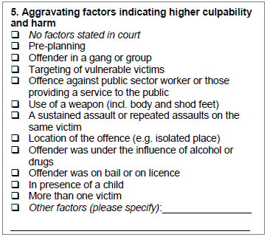
Problems: Non-Identifiability
Notes:
This is another example of non-identifiability from the old assaults questionnaire.
In fact here there was an option left for judges to tick when no aggravating factors were stated in court.
However, what we see is that that option is very rarely picked (see the little table), and I can claim that because in the table above I show the number of forms by the number of aggravating factors ticked, and actually 30% of the forms had nothing being ticked.
This is due to the poor design of the question, I reckon that if different questions had been created with the option of ticking yes it was found or not it wasn’t, it would have been better.

Slide 19
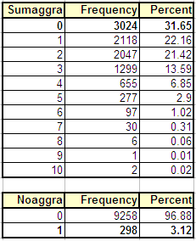
Problems: Non-Identifiability
Notes:
This is another example of non-identifiability from the old assaults questionnaire.
In fact here there was an option left for judges to tick when no aggravating factors were stated in court.
However, what we see is that that option is very rarely picked (see the little table), and I can claim that because in the table above I show the number of forms by the number of aggravating factors ticked, and actually 30% of the forms had nothing being ticked.
This is due to the poor design of the question, I reckon that if different questions had been created with the option of ticking yes it was found or not it wasn’t, it would have been better.

Slide 20

Probability Weights
Notes:
This is equivalent to using frequencies that we are aware of in the population and reweighting cases in our sample to match those frequencies from the population.
In the first table I show how we can calculate weights based on the distribution of gender in the population which we compare to the distribution that we have in our sample.
We can extend it easily to adjust for other auxiliary data, using a model.
However, this calculation of the sample size took into account a figure of sample size based on unit nonresponse.
in order to adjust for other sources of nonresponse we need additional calculations and it can get more complicated.
Finally, notice that we haven't used other than data from the register, this is less efficient than using everything available.
In the solution using imputations we could use variables from the questionnaire to predict other variables.

Slide 21
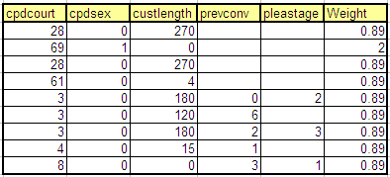
Probability Weights
Notes:
This is equivalent to using frequencies that we are aware of in the population and reweighting cases in our sample to match those frequencies from the population.
In the first table I show how we can calculate weights based on the distribution of gender in the population which we compare to the distribution that we have in our sample.
We can extend it easily to adjust for other auxiliary data, using a model.
However, this calculation of the sample size took into account a figure of sample size based on unit nonresponse.
in order to adjust for other sources of nonresponse we need additional calculations and it can get more complicated.
Finally, notice that we haven't used other than data from the register, this is less efficient than using everything available.
In the solution using imputations we could use variables from the questionnaire to predict other variables.

Slide 22
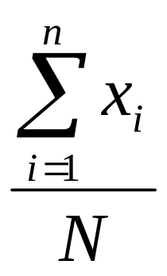
Functioning of Probability Weights
A standard sample mean
Notes:
We can make use of weights to get more representative estimates of the population.
Here I show how weights actually work for the example of a sample mean.

Slide 23
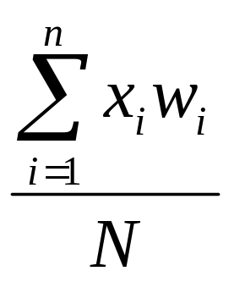
Functioning of Probability Weights
A standard sample mean
A weighted sample mean
Notes:
We can make use of weights to get more representative estimates of the population.
Here I show how weights actually work for the example of a sample mean.

Slide 24
Conclusion
 | Weighting | Imputation
Pros | Easy to implement | Statistically efficient
 | Parsimonious / robust | Flexible for multiple types of item nonresponse
Cons | Statistically inefficient | Computationally intensive
 | Bad for covering multiple missing patterns | Subject to nonsensical imputations
Notes:
I am going to conclude the talk by pointing at the main advantages and disadvantages of both methods.
Compared to imputations, weighting has the benefits of being easy to implement: in its simple form it is little more than running a regression model,
because of this reason of involving only one model, instead of many of them, we can be more sure that we haven’t made an error somewhere, or that some hypotheses haven’t been violated. That is, the model is more parsimonious.
The disadvantages is that it cannot make use of variables that are incomplete, that is it can only make adjustments based on the data from the MOJ, which is limited. Because of this it is less statistically efficient than imputations,
In addition, normally we can only adjust for one pattern of missing data (or missing data mechanism), combining weights for different variables can be complicated.
In spite of being a suboptimal method, I am now very much inclined to go for the simpler solution of using weights because of the problems that I have observed in the CCSS.

Slide 25
Conclusion
 | Weighting | Imputation
Pros | Easy to implement | Statistically efficient
 | Parsimonious / robust | Flexible for multiple types of item nonresponse
Cons | Statistically inefficient | Computationally intensive
 | Bad for covering multiple missing patterns | Subject to nonsensical imputations
In spite of being a suboptimal method, my choice would be to go for the simpler solution.
Notes:
I am going to conclude the talk by pointing at the main advantages and disadvantages of both methods.
Compared to imputations, weighting has the benefits of being easy to implement: in its simple form it is little more than running a regression model,
because of this reason of involving only one model, instead of many of them, we can be more sure that we haven’t made an error somewhere, or that some hypotheses haven’t been violated. That is, the model is more parsimonious.
The disadvantages is that it cannot make use of variables that are incomplete, that is it can only make adjustments based on the data from the MOJ, which is limited. Because of this it is less statistically efficient than imputations,
In addition, normally we can only adjust for one pattern of missing data (or missing data mechanism), combining weights for different variables can be complicated.
In spite of being a suboptimal method, I am now very much inclined to go for the simpler solution of using weights because of the problems that I have observed in the CCSS.

Slide 26

Questions?

